Slide 1

An ICP-Based Navigation System for Human Support Robot
第36回 日本ロボット学会 学術講演会
Zhang Haibin
Tokyo Metropolitan University
Prof. Kubota Naoyuki
Notes:
Hi, everybody, I am zhang haibin, from Tokyo metropolitan university, the Kubota labrotory. today my speech title is …;

Slide 2
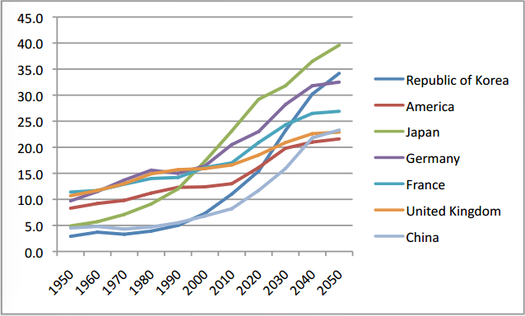
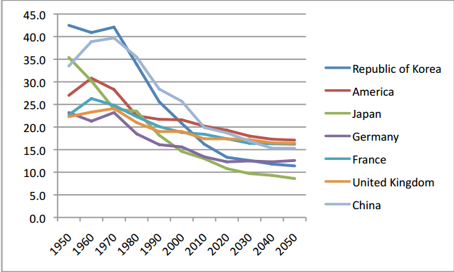
Background: Aging Society
Imbalance of population in Japan due to increasing number of elderly and declining births.
Elderly people: above 65
Young people: under 15
Reference
Statistics Bureau, Ministry of Internal Affairs and Communications, “population estimates,” September 2012.
2) Tokyo Fire Department, Disaster Division, Community Safety andDisaster Education, “Conflagration and daily life accident data based on elderly people current situation,” p. 27, 2010
Notes:
In Japan, because of increasing number of elderly and decreasing young people, the Imbalance of population is a big problem. From the graph, the ratio elderly people (Over 65 years old) is increasing, and when it become to 2050, 40% Japanese will be above 65 years old. On the other hand, the population of young people will only be 10% in 2050.

Slide 3
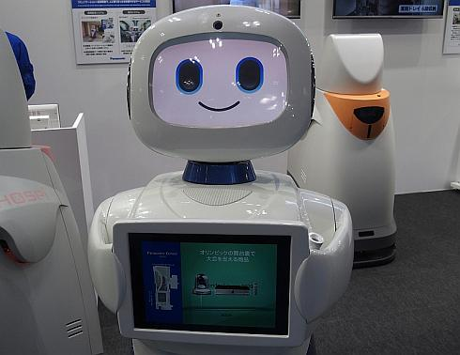
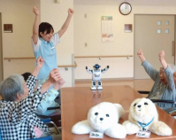

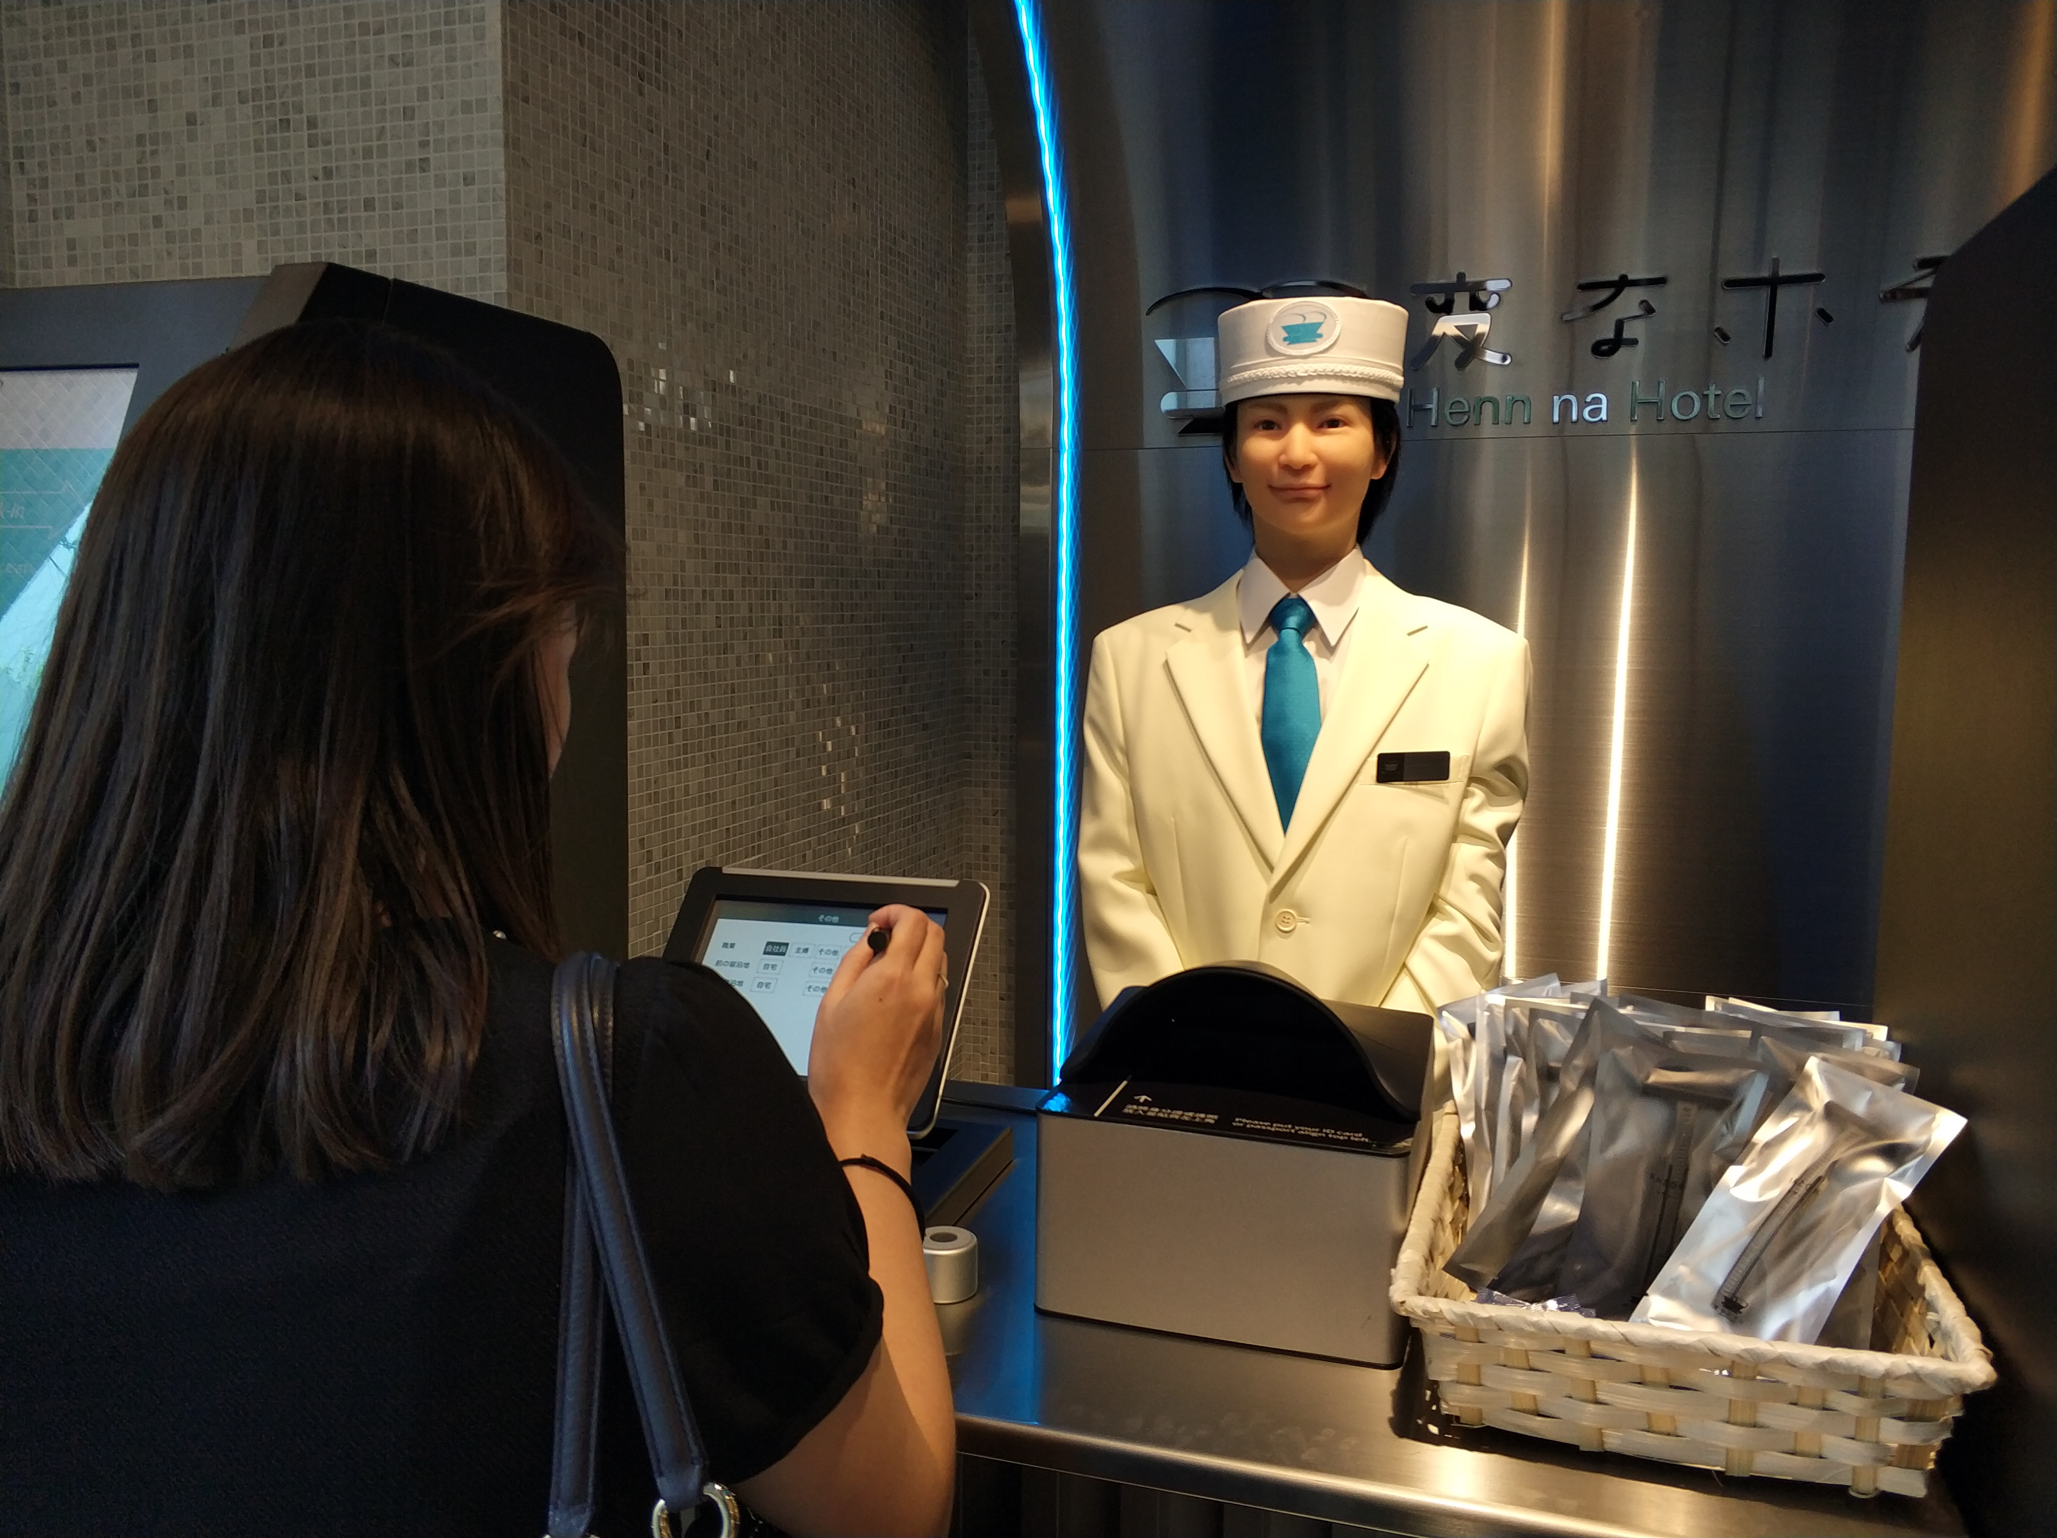
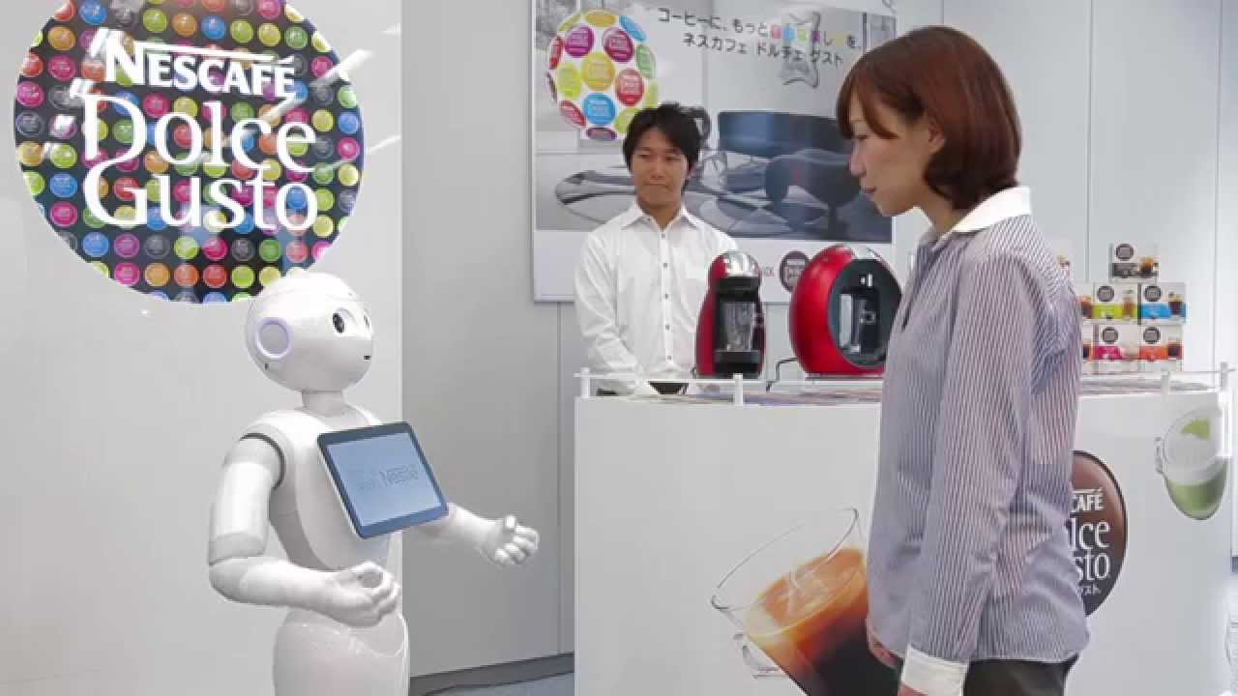
Background: Development of Robots
For people in need of nursing care
Reduced labor input due to wage gap in service industry
It leads to a lack of labor
The robot is one of the solution.
HOSPI-Rimo
PALRO
Gemili
Public
Private
Hotel reception
pepper
For healthy people
Notes:
How to solve with this problem? The robot is one of the solution. Many researches are focusing on nursing and service robots to help ease the burden on society. For example. we are familiar with hotel reception robot and pepper. Generally, According to the functionality of the robot, we use four dimentions. in public or private area, or for healthy people or for people in need of nursing care. we mainly focus on indoor service robot.

Slide 4
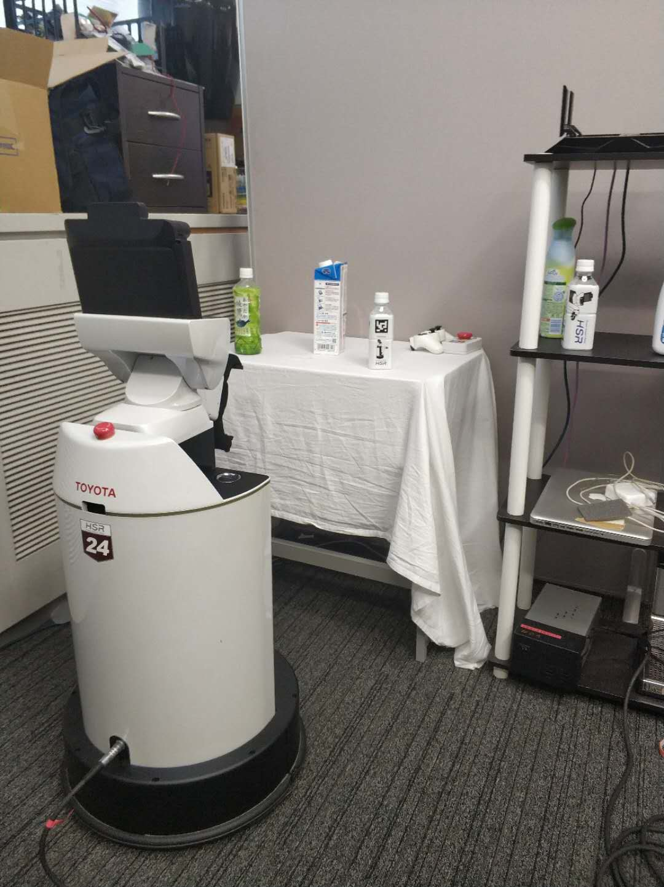
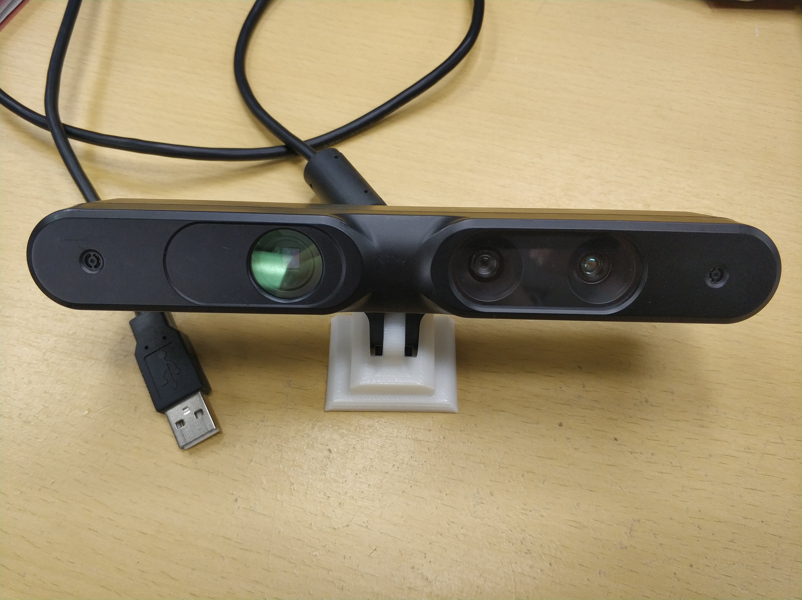
Background: Human Support Robot
Depth Sensors
USB-powered, making it more suitable to botball-style robotics.
Cheap cost
Color image
Depth image
Cloud points
Notes:
Specifically, in our research, we use Human support robot developed by Toyota in 2006. it can pick up and fetch object, and Manual Control. Imaging a family service scene, when people hope to control HSR to get some a milk box on the table through voice commands or tablet. Therefore, it can be used to ease the life burden of those who need help.
There are many sensors in HSR, in the head we had a depth sensors. When it capture a picture, we can get both color image and depth image. So It can be used to compute distance information in the image. It is usb-powered and easy to set on the robot. And it is also cheap and small.

Slide 5
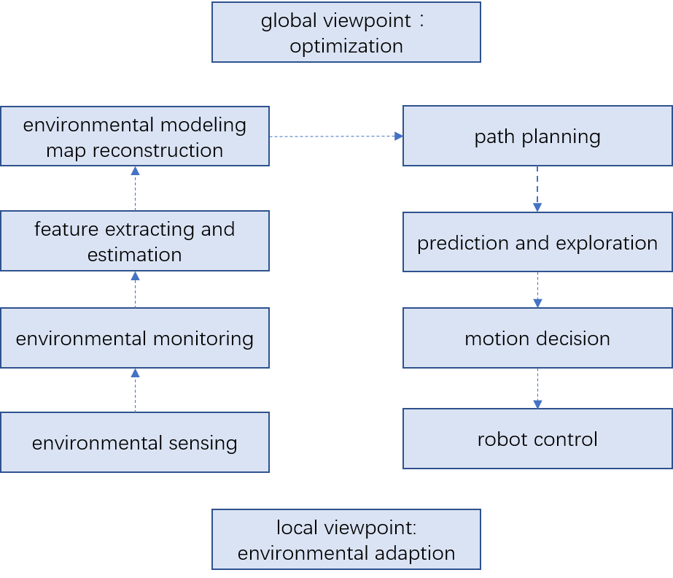
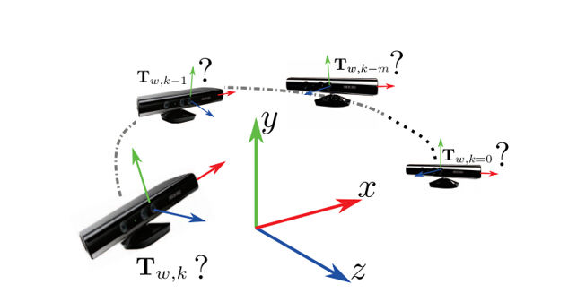
Research Aim
Estimation of motion position of HSR
Depth Sensor
Pipeline of Indoor service process
PROBLEM?
World coordinate system x, y, z
Find the camera local coordinate system
(determine the position of the camera in the world coordinate system in each frame)
Notes:
For our whole research aim, we would like to introduce a robot navigation system. Depending on robot’s sensors to obtain environmental information, we can extract image feature and set those features as landmark. then, we get the environmental model. For the right part, it is for robot navigation and control for a specific target. With the map model, mobile robots can then navigate autonomously, exploring in the map and deciding the optimizing way.
Till now, we mainly focus on left part. Specifically, the estimation of moving path of HSR in the environment. That is, also means the estimation of position of depth sensor.
Therefore, our research point is that we set a world coordinate system x, y, z, then we need to find the camera local coordinate system. And determine the position of the camera in the world coordinate system in each frame.

Slide 6
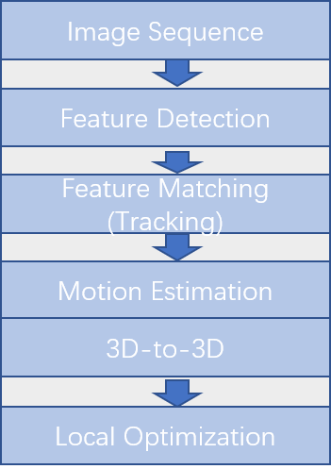
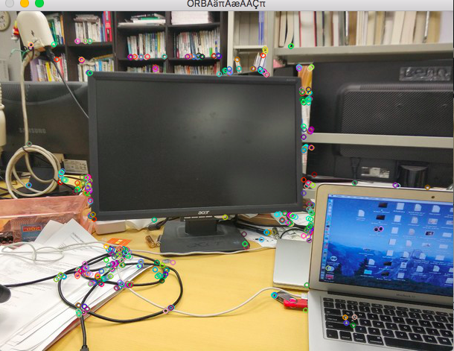
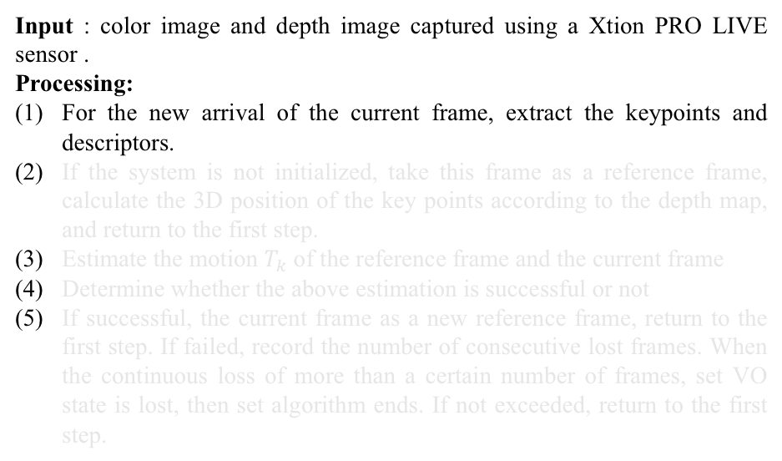
System Overview
Input : color image and depth image captured using a Xtion PRO LIVE sensor .
Processing:
For the new arrival of the current frame, extract the keypoints and descriptors.
If the system is not initialized, take this frame as a reference frame, calculate the 3D position of the key points according to the depth map, and return to the first step.
Estimate the motion $T_{k}$of the reference frame and the current frame
Determine whether the above estimation is successful or not
If successful, the current frame as a new reference frame, return to the first step. If failed, record the number of consecutive lost frames. When the continuous loss of more than a certain number of frames, set VO state is lost, then set algorithm ends. If not exceeded, return to the first step.
(1) Feature detection
ORB Feature: fast and stable
Step 1: Detect Oriented FAST keypoint detector.
Step 2: Calculate the BRIEF description based on the keypoint.
Notes:
Here is our system overview.
Our input data is color image and depth image captured by sensor .
The first step, For the new arrival of the current frame, extract the keypoints and descriptors.
We use ORB Feature. It is very fast compared with other feature, such as SIFT feature.
Step 1: Detect Oriented FAST keypoint detector.
Step 2: Calculate the BRIEF description based on the keypoint.
Then we can get the feature of one frame.

Slide 7
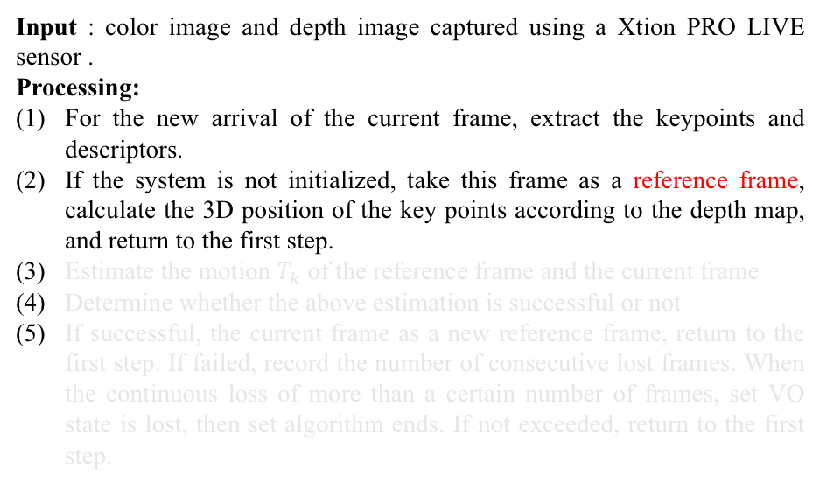
System Overview
Input : color image and depth image captured using a Xtion PRO LIVE sensor .
Processing:
For the new arrival of the current frame, extract the keypoints and descriptors.
If the system is not initialized, take this frame as a reference frame, calculate the 3D position of the key points according to the depth map, and return to the first step.
Estimate the motion $T_{k}$of the reference frame and the current frame
Determine whether the above estimation is successful or not
If successful, the current frame as a new reference frame, return to the first step. If failed, record the number of consecutive lost frames. When the continuous loss of more than a certain number of frames, set VO state is lost, then set algorithm ends. If not exceeded, return to the first step.
Set World coordinate system x, y, z
Notes:
The second step is use the first frame as a reference frame, so we can set world coordinate system.

Slide 8
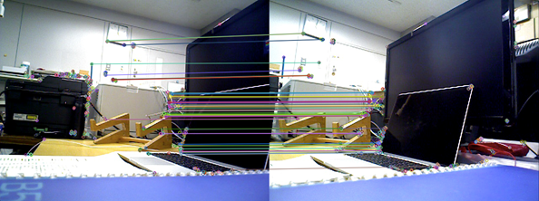
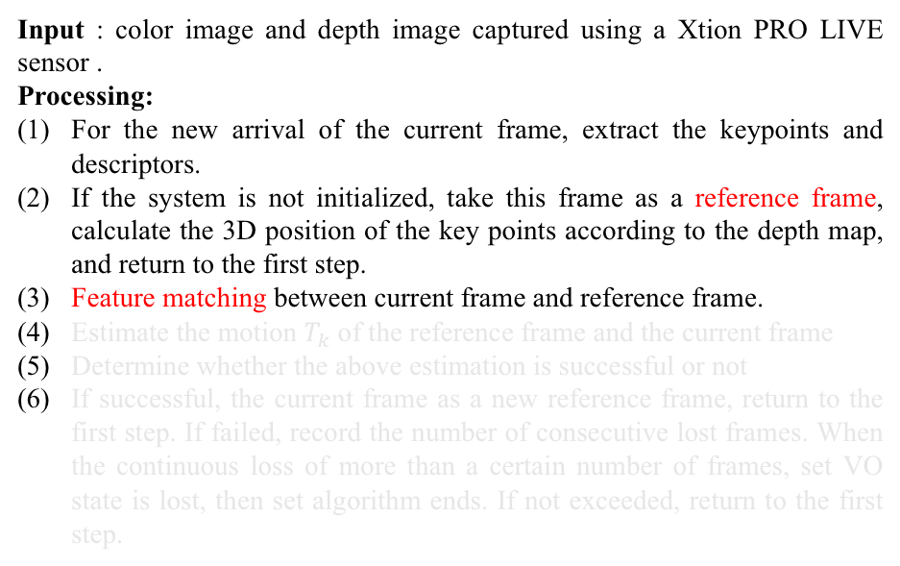
System Overview
Input : color image and depth image captured using a Xtion PRO LIVE sensor .
Processing:
For the new arrival of the current frame, extract the keypoints and descriptors.
If the system is not initialized, take this frame as a reference frame, calculate the 3D position of the key points according to the depth map, and return to the first step.
Feature matching between current frame and reference frame.
Estimate the motion $T_{k}$of the reference frame and the current frame
Determine whether the above estimation is successful or not
If successful, the current frame as a new reference frame, return to the first step. If failed, record the number of consecutive lost frames. When the continuous loss of more than a certain number of frames, set VO state is lost, then set algorithm ends. If not exceeded, return to the first step.
Match the BRIEF descriptors in the two images, using Hamming distance.
Notes:
The third step is do feature matching between current frame and reference frame. We match the brief descriptors detected in the first step and using hamming distance to minimize the the matching error.

Slide 9
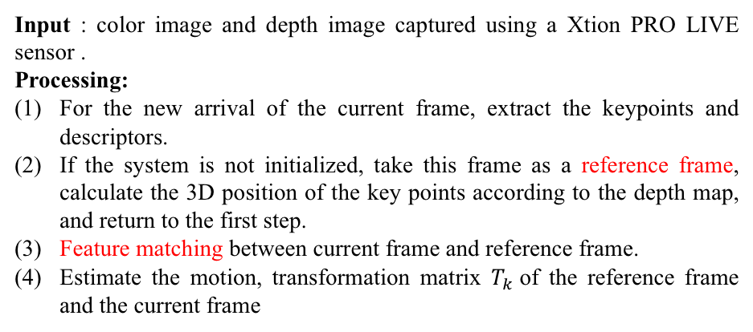
System Overview
Input : color image and depth image captured using a Xtion PRO LIVE sensor .
Processing:
For the new arrival of the current frame, extract the keypoints and descriptors.
If the system is not initialized, take this frame as a reference frame, calculate the 3D position of the key points according to the depth map, and return to the first step.
Feature matching between current frame and reference frame.
Estimate the motion, transformation matrix $T_{k}$of the reference frame and the current frame
Notes:
Then, we Estimate the transformation matrix $T_{k}$of the reference frame and the current frame

Slide 10
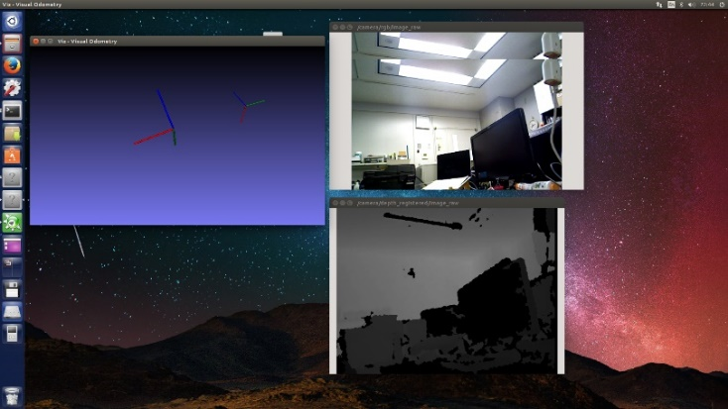
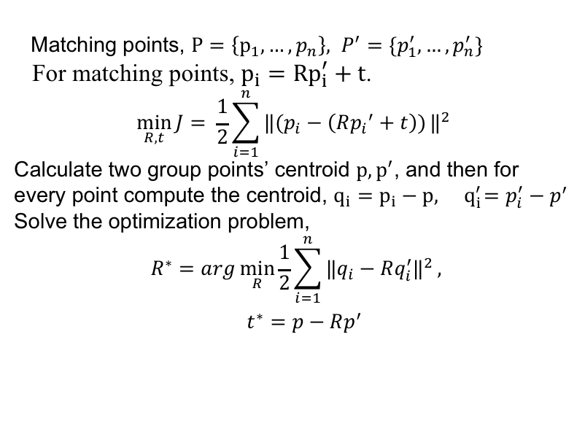
Method
Using iterative Closest Point (ICP) to compute R, t
transformation matrix 𝑇 ( rotation matrices R + translation matrices t)
The estimation of position using depth sensors
Matching points, $P=\left\{p_{1},…,p_{n}\right\}, P^{′}=\{p_{1}^{′},…,p_{n}^{′}\}$
For matching points, $p_{i}={Rp}_{i}^{′}+t$.
$$\min_{R,t}{J}= \frac{1}{2}\sum_{i=1}^{n}{‖(p_{i}−\left(R{p_{i}}^{′}+t\right))}‖^{2}$$
Calculate two group points’ centroid $p, p^{′}$, and then for every point compute the centroid, $q_{i}=p_{i}−p, { q}_{i}^{′}=p_{i}^{′}−p^{′}$
Solve the optimization problem,
$$R^{∗}=arg\min_{R}{\frac{1}{2}\sum_{i=1}^{n}{‖q_{i}−Rq_{i}^{′}‖^{2}}},$$
$$t^{∗}=p−Rp^{′}$$
Notes:
We get the corresponding relationship between the feature points of the image, so we can use 3d-3d matching points’ pair to estimate the motion of camera.
Here we use ICP to compute rototaion matric and translation matric which is equal to transformation matrix.
We have two frames’s matching points, P, P prime。
For every matching point, we have the equation above.
Then we calculate two group points’ centroid $p, p^{′}$,
for every point compute qi, qi prime
Then we substitude pi,pi prime
Solve the optimization problem,
We can get R star and t star.
That the basic way we estimate the position of depth sensor.

Slide 11
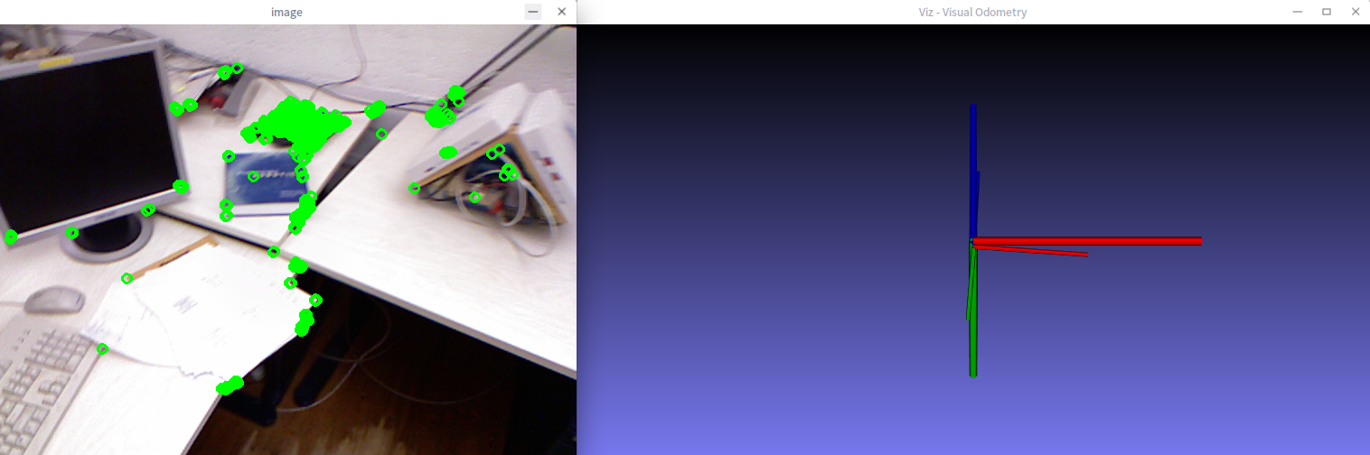
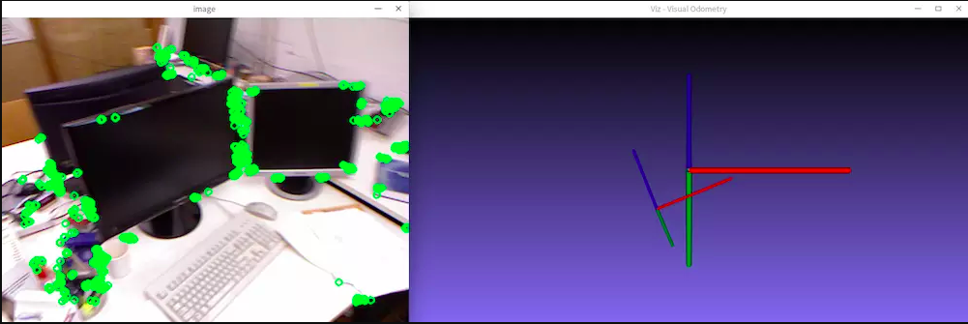
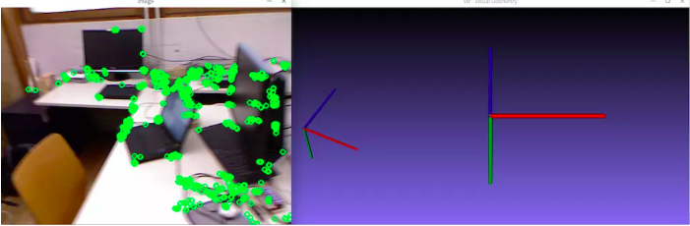

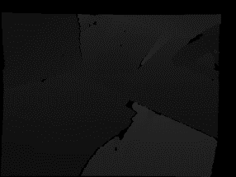
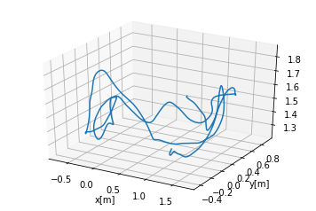
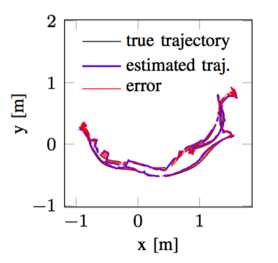
Experiments
Trajectory change using Xtion
Using TUM datasets (rgbd_dataset_freiburg1_desk)
Visualization of the ground-truth and the estimated trajectory.
Duration | 23.40s
Duration with ground-truth | 23.35s
Ground-truth trajectory length | 9.263m
Avg. translational velocity | 0.413m/s
Avg. angular velocity | 23.327deg/s
Trajectory dim. | 2.42m * 1.34m * 0.66m
Fig. 6 Example of freiburg1_desk dataset
Notes:
For experiments, we use the TUM dataset for the evaluation.
The dataset contains color images, depth image.
The table show the basic information of video stream. We can know the duration and trajectory length and velocity.
The picture shows the feature points in the current frame, and the right picture shows the changes of local coordinate system.
Then we visualize the trajectory of ground-truth and the estimated.

Slide 12
Conclusions and Future works
We proposed a way to estimate the position of robot using RGB image and depth maps captured by Xtion.
Some drawbacks exist: 1) Easy to lose. When the frame moves too fast, it will cause the feature point to be lost. 2) Trajectory drift. The main reason is that the error of each position estimation will be accumulated, resulting in inaccurate estimation.
In future works, once the environment information obtained, we hope to control the HSR’s moving path and choose the optimal path.
We will improve our system, and we hope that HSR can fulfill their tasks according to human instructions to serve human beings to reduce their workload.

Slide 13
Thank you for your attention!

